Slide 1
CORPORACION FAVORITA GROCERY SALES FORECASTING
Dain Thengunnal
12-12-2018

Slide 2
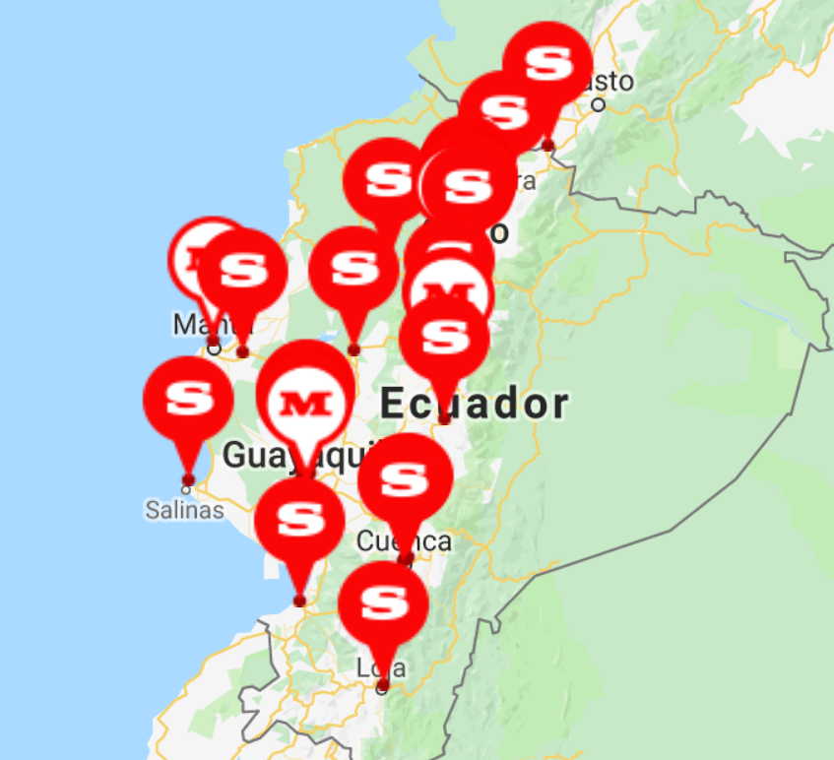
About
Corporacion Favorita is a large Ecuadorian-based grocery retailer who operates 54 supermarkets across Ecuador.

Slide 3
Problem
There is a delicate balance between purchasing and sales forecasting.
Subjective forecasting methods leads to overstocking or understocking.
overstocking results in wastage
understocking results in customer dissatisfaction

Slide 4
Challenge
Build a machine learning model that accurately predicts unit sales for an item, store and date.

Slide 5
Approach
Data Load
and
Overview
Data
Wrangling
Exploratory Data Analysis
Feature
Engineering
Model Building
and
Prediction
Evaluation of
prediction results

Slide 6
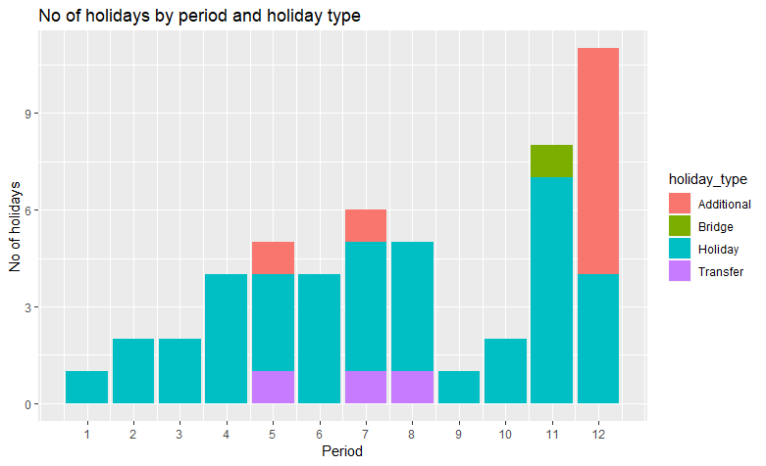
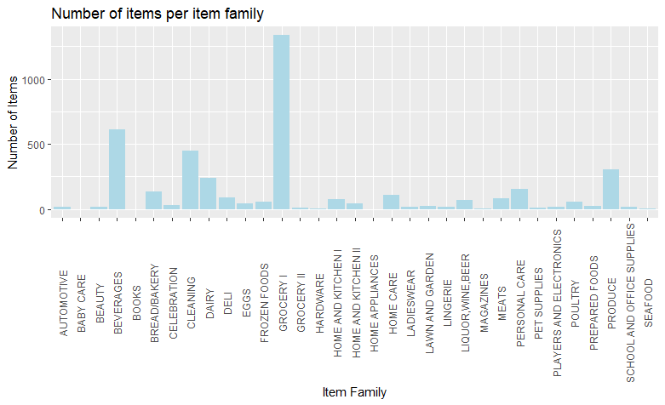
Exploratory Data Analysis

Slide 7
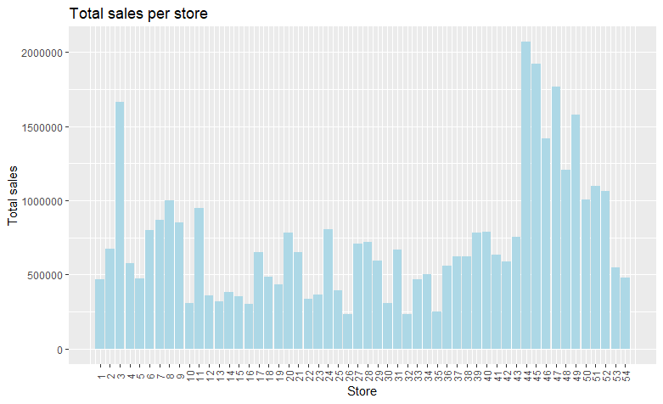
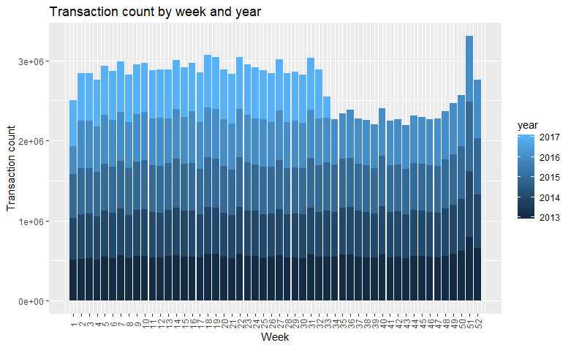
Exploratory Data Analysis

Slide 8
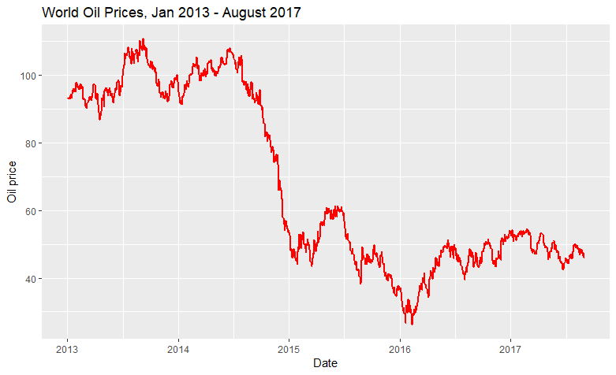
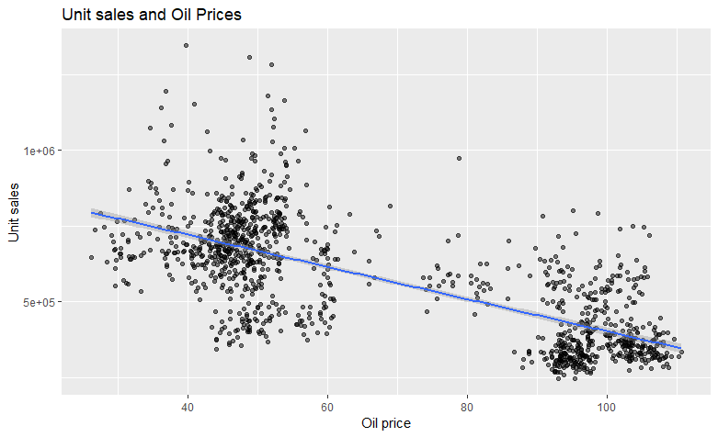
Exploratory Data Analysis

Slide 9
Solution
Predicted unit sales using
Formula:
unit sales ~ week day + previous day's unit sales + rolling mean of unit sales for last 7 days + on promotion + oil price + item class + perishable
Models:
XGBoost
Random Forest

Slide 10
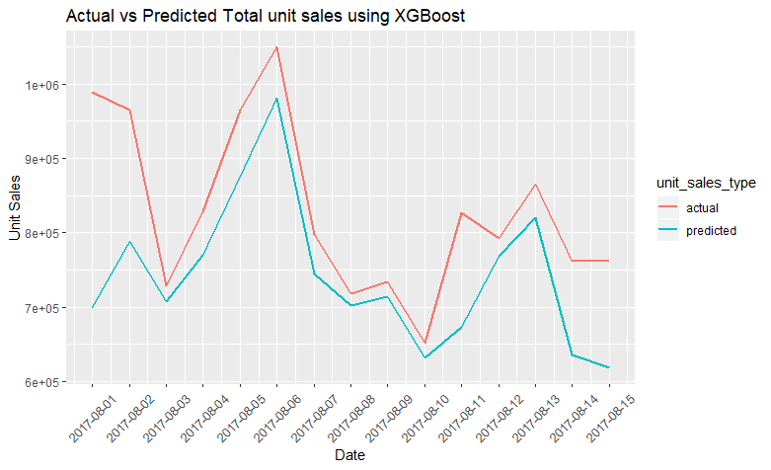
Performance of XGBoost model
NWRMSLE : 0.5455906
RMSE : 15.96259

Slide 11
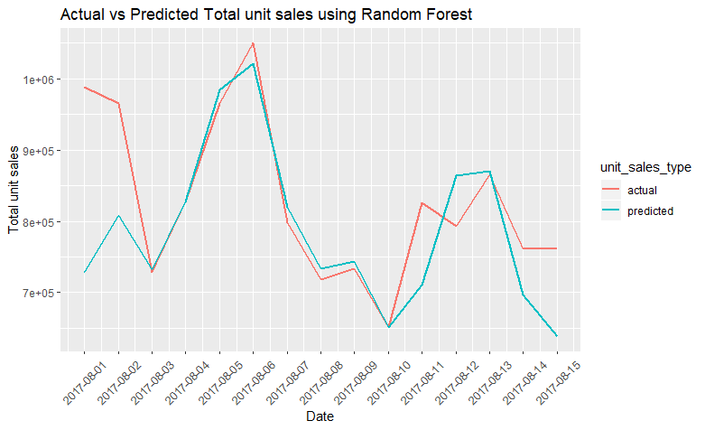
Performance of Random Forest model
NWRMSLE : 0.5734197
RMSE : 16.55909

Slide 12
Limitations
Used only 4% of train data for training
Prediction error is more at the start and end of a prediction period
Model not tested for scalability

Slide 13
Areas of Improvement
Tune model parameters
Build additional models
Blend weather and demographics
Use bigger sample size for training

Slide 14
Source code
https://github.com/logicshare/Favorita

